Slide 1

MEGC MATLAB Technical Workshop
Denislav Nikolov
October 29th , 2020

Slide 2
Workshop Outline
Part 1: MATLAB Basics/Recap (~50 min)
Why MATLAB?
Programming Basics
MATLAB Interface
Plotting
Helpful functions and tools
Additional Resources
Break (~10 Min)
Part 2: MATLAB Problem Solving (~1 Hour)
3 Application Problems
MEGC MATLAB Technical Workshop
October 29th, 2020

Slide 3
Part 1: Fundamentals
MEGC MATLAB Technical Workshop
October 29th, 2020

Slide 4
Why MATLAB?
MEGC MATLAB Technical Workshop
October 29th, 2020

Slide 5


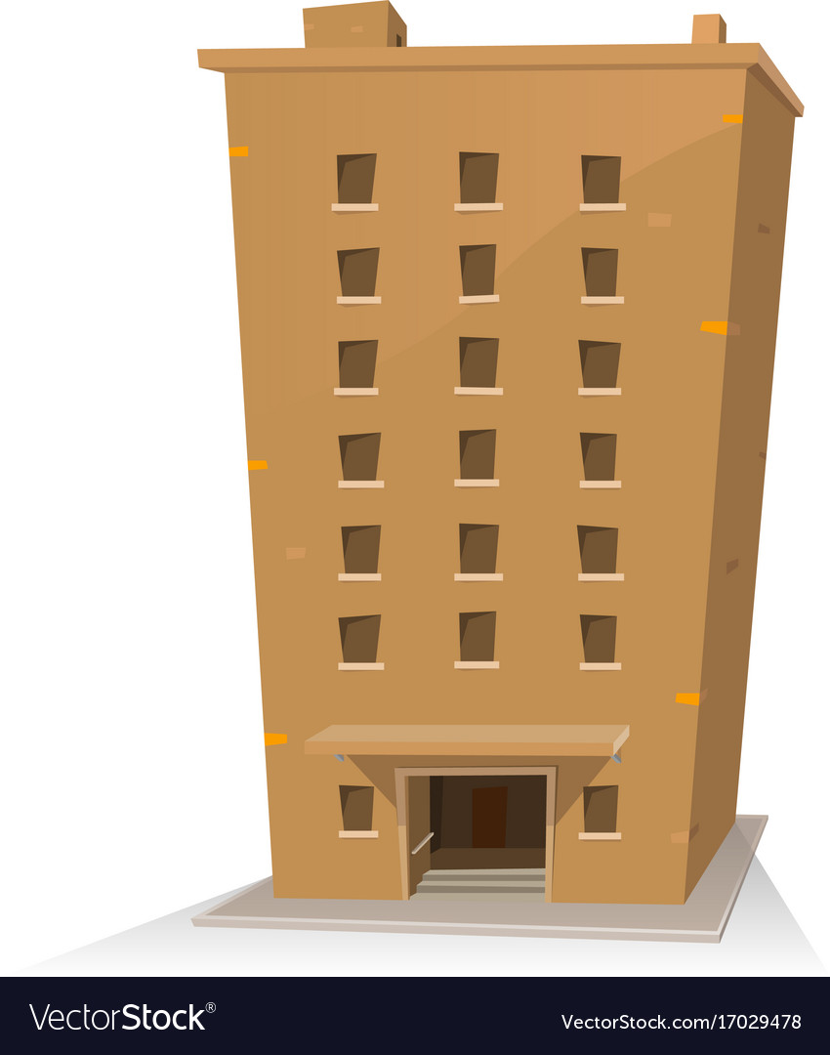


What is Engineering?
Input (tools, equations)
Function (engineer, program)
Output (structure, vehicle)
MEGC MATLAB Technical Workshop
October 29th, 2020

Slide 6
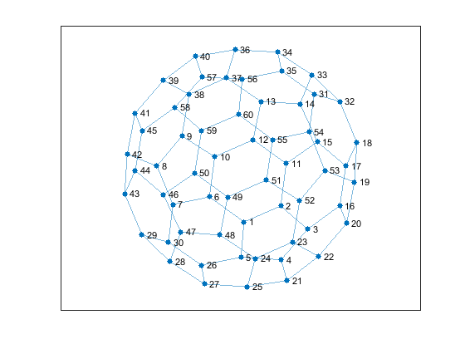
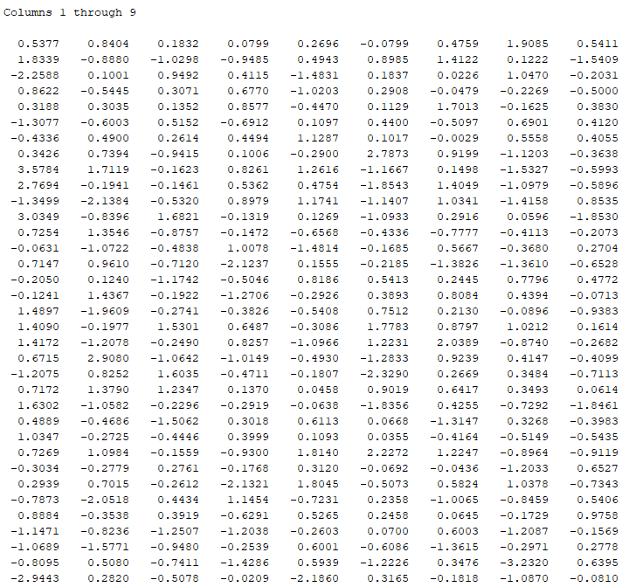
MATLAB is Like Us
Input
Function
Output
MATLAB has a nearly infinite library of functions
[output] = function(input)
MATLAB can deal with large quantities of data in convenient matter
A =
[graph] = dodec(A)
. . .
MEGC MATLAB Technical Workshop
October 29th, 2020

Slide 7
MATLAB Interface
MEGC MATLAB Technical Workshop
October 29th, 2020

Slide 8
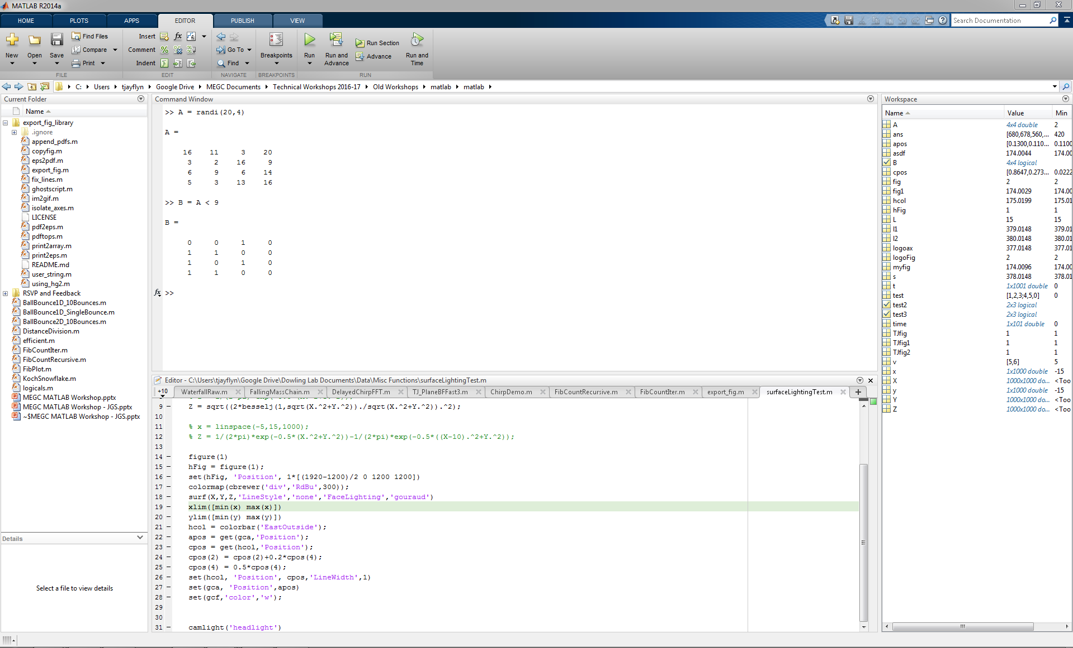
Navigating the UI
MEGC MATLAB Technical Workshop
October 29th, 2020

Slide 9
Navigating the UI
MEGC MATLAB Technical Workshop
October 29th, 2020

Slide 10
Basic Commands
To clear your command window: clc
To close all figures: close all
To clear your workspace: clear all
To stop a runaway code: ctrl+c
To comment out a line of code: % (at beginning)
To comment out a block of code:
Highlight, then ctrl+r
To comment in a block of code:
Highlight, then ctrl+t
MEGC MATLAB Technical Workshop
October 29th, 2020

Slide 11
… and the most useful command
If you don’t know how to use a built-in command or function:
>> help myFunction
And remember, Google is your best friend!
MEGC MATLAB Technical Workshop
October 29th, 2020

Slide 12
MATLAB Basics
MEGC MATLAB Technical Workshop
October 29th, 2020

Slide 13
Variable Types
Most of the time, you won’t need to explicitly define these
Characters:
Complex numbers:
Decimal numbers:
Integer numbers:
Logic statements (T/F):
Structures:
char,string
complex
double/single
int8,int16,uint8
logical
struct
MEGC MATLAB Technical Workshop
October 29th, 2020

Slide 14
Variable Types: MATLAB Auto Recognition
‘data’,”data”
num + num*i
num.12345
Explicit
Explicit
Explicit
char,string
complex
double/single
int8,int16,uint8
logical
struct
MEGC MATLAB Technical Workshop
October 29th, 2020

Slide 15
Variable Types: Converting
Converting from numerical data types
Rounding regularly, up, or down values
Other functions:
double(input), num2str(inpt)
round(input,n)
floor(input)
ceil(input)
string(input)
int2str(input)
str2double(input)
MEGC MATLAB Technical Workshop
October 29th, 2020

Slide 16
Logic Statements
Logic statements are crucial towards decision making processes in programs
Run code if condition is true
Run code if other condition is true
Run code for any other non-stated condition
if statement
run code...
elseif statement
run code...
else
run code...
end
MEGC MATLAB Technical Workshop
October 29th, 2020

Slide 17
Logic Statements: Operators
These operators output a value of true or false based on properties of a variable in question.
Relational (comparison) operators:
Less/greater than: >, >=, <, <=
Equal/not equal: ==, ~=
(use = for assignments only)
Logical operators
Used in decision-making, array indexing, etc.
AND: && (& for whole arrays)
OR: || (| for whole arrays)
MEGC MATLAB Technical Workshop
October 29th, 2020

Slide 18
Logic Statements: If-Else Example
if i == 1
disp 'Hello World';
elseif i > 2
disp 'Hello Other World';
else
disp 'Hello You';
end
MEGC MATLAB Technical Workshop
October 29th, 2020

Slide 19
Logic Statements: While Loops
Run code while condition is true
while statement
run code...
end
i = 0;
while i > 1
disp 'Hello World'
i = i + 0.5;
end
Warning: While loops have a danger of being endless. Press Ctrl+C to end code in MATLAB
MEGC MATLAB Technical Workshop
October 29th, 2020

Slide 20

Logic Statements: For Loops
Run code continuously between a range of values
for range
run code...
end
for i = 1:10
disp 'Hello World'
end
For loops will most likely help with the potential infinite loop problem presented in the while loop
MEGC MATLAB Technical Workshop
October 29th, 2020

Slide 21
Matrices/Vectors
Matrices are multidimensional groups of indexed doubles. Matrices are the core of MATLAB computing.
Build arrays using brackets ([]) with commas or spaces between entries within the same row and semicolons (;) to start a new row.
Vectors are m × 1 or 1 × n -dimensional arrays. Vectors are often defined by themselves or they can be created by taking a part of a column or row of a larger array using the colon (:) operator.
MEGC MATLAB Technical Workshop
October 29th, 2020

Slide 22
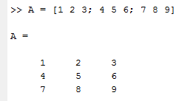

Matrices/Vectors: Indexing and Slicing
MEGC MATLAB Technical Workshop
October 29th, 2020

Slide 23

Matrices/Vectors: Indexing and Slicing
MEGC MATLAB Technical Workshop
October 29th, 2020

Slide 24

Matrices/Vectors: Indexing and Slicing
MEGC MATLAB Technical Workshop
October 29th, 2020

Slide 25
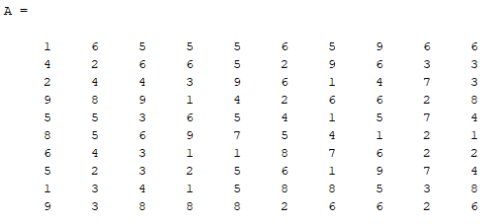
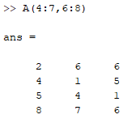
Matrices/Vectors: Indexing and Slicing
6
8
4
7
MEGC MATLAB Technical Workshop
October 29th, 2020

Slide 26
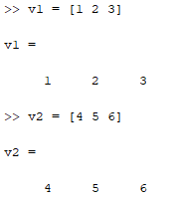
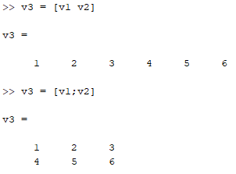
Matrices/Vectors: Combining Two Vectors
MEGC MATLAB Technical Workshop
October 29th, 2020

Slide 27


Matrices/Vectors: Combining Two String Vectors
MEGC MATLAB Technical Workshop
October 29th, 2020

Slide 28
Variables Types – Cell Arrays
Cell Arrays are multidimensional groups of indexed data containers. Cell arrays are a powerful extension of the normal array, as each cell may contain any data type and can be any size.
Build cell arrays just like you would normal arrays, except use braces ({}) instead of brackets ([]).
B =
2×2 cell array
{1×10 double} {'my string'}
{[ 2]} {2×2 double }
>> a = linspace(1, 10, 10);
>> b = ’my string’;
>> c = 2;
>> d = [1, 2; 3, 4];
>> B = {a, b; c, d};
MEGC MATLAB Technical Workshop
October 29th, 2020

Slide 29
Matrices/Vectors: Lin. Algebra
For computations involving vectors and arrays, often you must use the elementwise operator (.)
>> A = [1, 4, 9; 16, 25, 36; 49, 64, 81];
>> A^2
ans =
506 680 882
2180 2993 3960
5042 6980 9306
>> A.^2
ans =
1 16 81
256 625 1296
2401 4096 6561
MEGC MATLAB Technical Workshop
October 29th, 2020

Slide 30
Functions: Useful Functions
MATLAB has a nearly infinite library of functions
[output] = function(input)
Plot:
Numerical integration:
Backward Slash (Ax=b):
Array of Zeros (m X n):
Identity Matrix (m X m):
Vector of Linearly Spaced-Points (a→b):
plot(x,y)
integral(fun,a,b)
X = A\b
zeros(m,n)
eye(m)
linspace(a,b,n)
MEGC MATLAB Technical Workshop
October 29th, 2020

Slide 31
Functions: User-defined Functions
[output] = function(input)
function [output1,output2,…] = func_name(arg1,arg2,…)
statements
end
The name of the function must match the name of the m-file in which it lives – MATLAB will warn you if it is not
MEGC MATLAB Technical Workshop
October 29th, 2020

Slide 32
Plots: 2-D Plots
MATLAB is very often used to generate plots. To generate a 2-D line plot, use the following syntax:
plot(x,y,‘name’,value,…)
where the ‘name’,value pairs are used to configure the individual features of the line. Other plot features are controlled using related functions that are called independently. For example:
plot(t, sin(t), ‘r-’)
plot(x,y,’Linewidth’,2)
xlabel(‘time’)
legend(‘Trial 1’, ‘Trial 2’)
MEGC MATLAB Technical Workshop
October 29th, 2020

Slide 33
Plots: Other Plots to Explore
Scatter plot:
Histogram:
3D plot:
3D scatter plot:
Plots (n X m) in 1 figure:
Log plot:
Semilog plot:
Polar coordinate plot:
scatter(x,y)
histogram(x)
plot3(x,y,z)
scatter3(x,y,z)
subplot(n,m,i)
loglog(x,y)
semilogx(x,y)
semilogy(x,y)
polarplot(θ,r)
MEGC MATLAB Technical Workshop
October 29th, 2020

Slide 34
Plots: Other Function Plots
Label x/y axis:
Title your plot:
Title your figure:
Change axis sizes:
xlabel(‘name’)
ylabel(‘name’)
title(‘name’)
sgtitle(‘name’)
axis([xmin xmax ymin ymax])
xlim([xmin xmax])
ylim([ymin ymax])
MEGC MATLAB Technical Workshop
October 29th, 2020

Slide 35
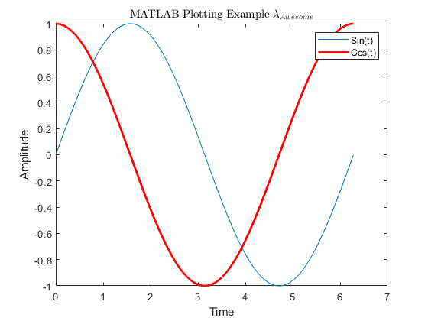
Plots: 2-D Plots Example
t = 0:0.01:2*pi();
y1 = sin(t);
y2 = cos(t);
plot(t,y1)
hold on
plot(t,y2, 'r-','Linewidth',2)
xlabel('Time')
ylabel('Amplitude')
legend('Sin(t)','Cos(t)')
title('MATLAB Plotting Example $$\lambda_{Awesome}$$','Interpreter','latex')
MEGC MATLAB Technical Workshop
October 29th, 2020

Slide 36
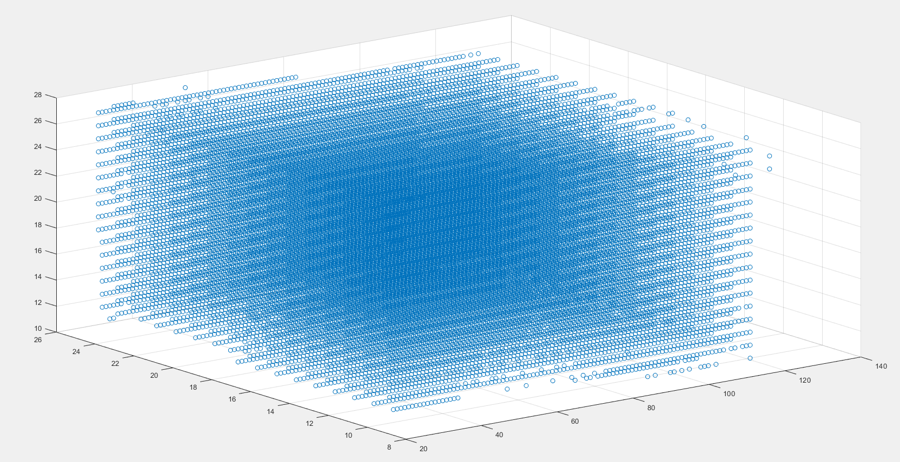
Plots: 3-D Plots Example
scatter3(x,y,z)
MEGC MATLAB Technical Workshop
October 29th, 2020

Slide 37
Helpful Functions and Tools
MEGC MATLAB Technical Workshop
October 29th, 2020

Slide 38
Symbolics Functions
Syms functions allow you to manipulate equations
Declare your function
and variables
Integral
Derivative
Step function
Plot syms function
Solve for a variable
Plug value into variable
syms f
syms x y
int(f,x,[a b])
diff(f,x)
heaviside(x)
fplot(f)
solve(f,x)
subs(f,x,a)
MEGC MATLAB Technical Workshop
October 29th, 2020

Slide 39
Symbolics Functions: Example
syms x y z
f(x,y,z) = x^2 + y^2 + z^2;
Derivative
>> diff_T = diff(f,x)
diff_T(x, y, z) =
2*x
Solving for x
>> what_is_x = solve(f,x)
what_is_x =
(- y^2 - z^2)^(1/2)
-(- y^2 - z^2)^(1/2)
Definite Integral
>> int_T = int(f,x,[0 1])
int_T(y, z) =
y^2 + z^2 + 1/3
MEGC MATLAB Technical Workshop
October 29th, 2020

Slide 40
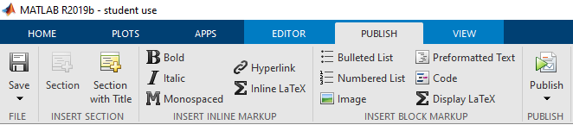
Publish (Nice PDF)
MEGC MATLAB Technical Workshop
October 29th, 2020

Slide 41
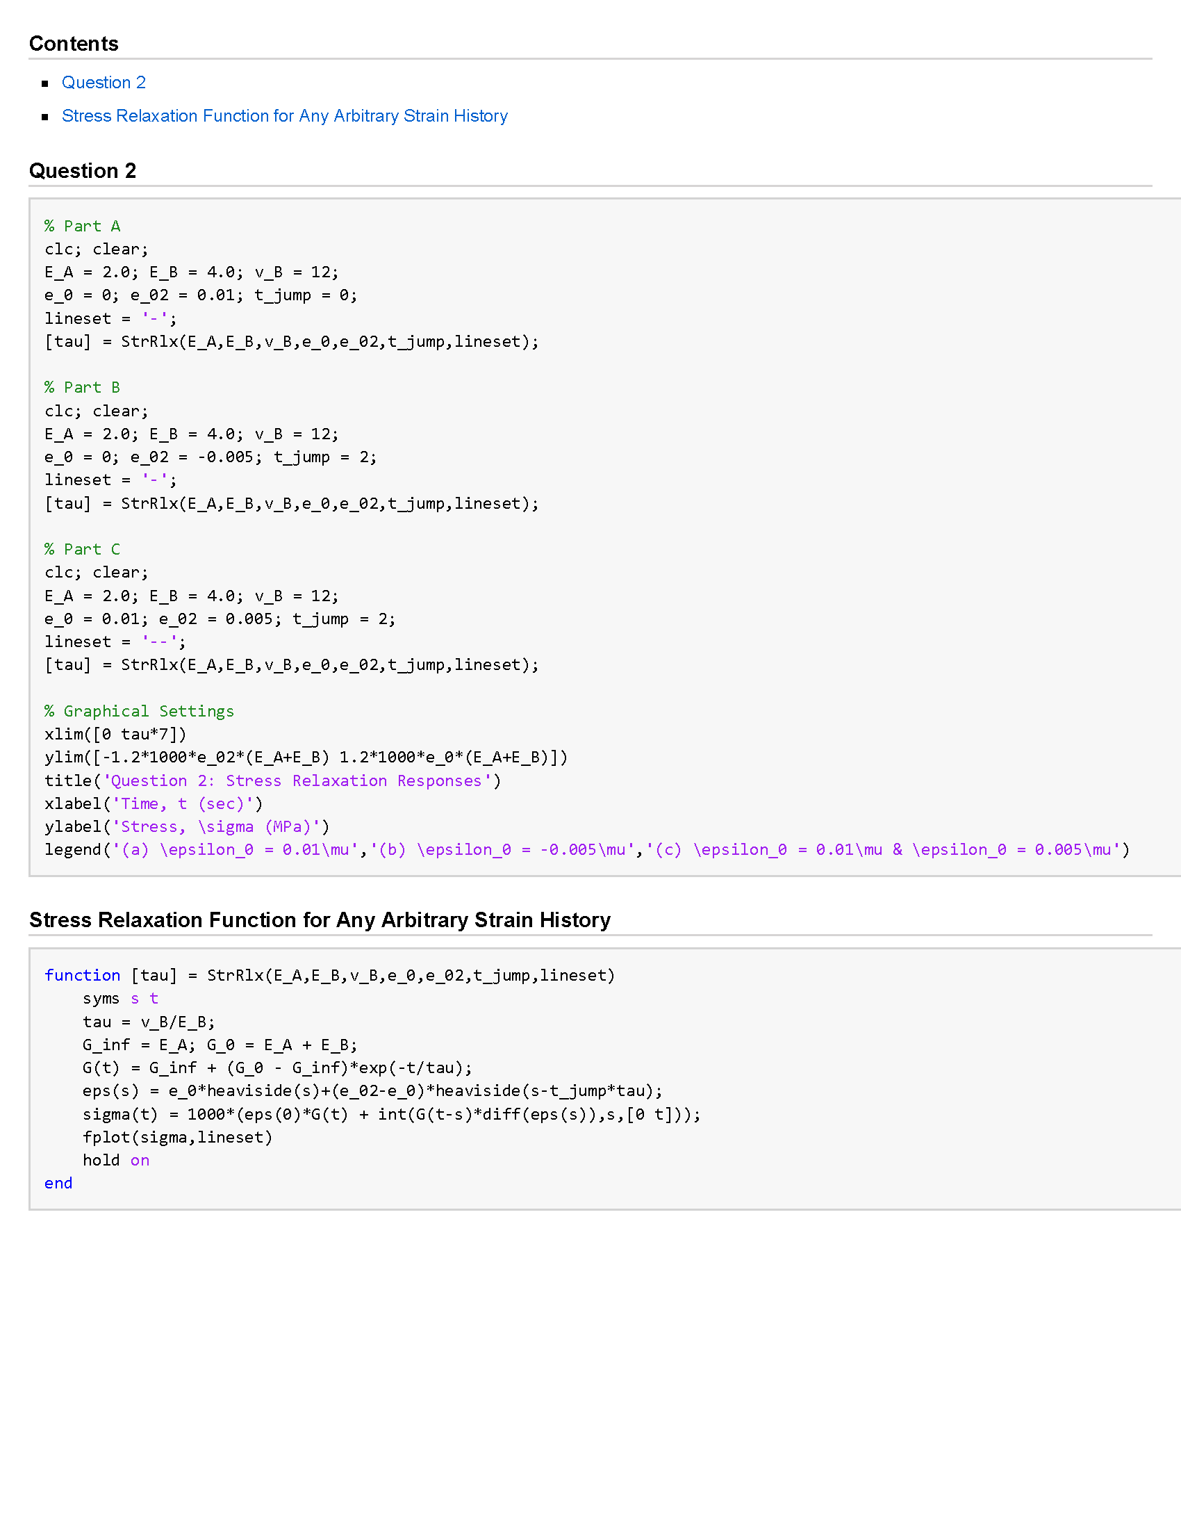
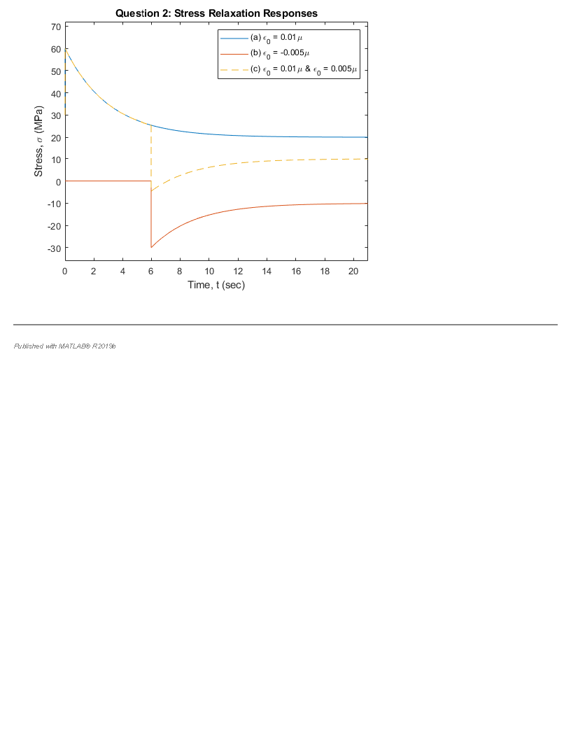
Publish (Nice PDF)
Page 1
Page 2
MEGC MATLAB Technical Workshop
October 29th, 2020

Slide 42
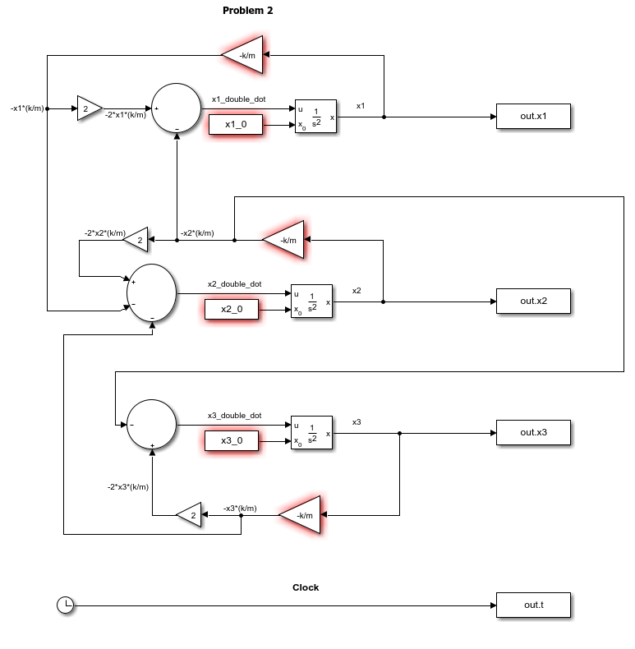
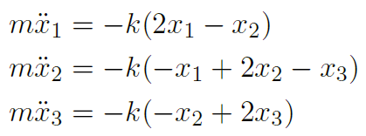
Simulink
Method of solving Ordinary Differential Equations with block diagrams to solve for ODE
MEGC MATLAB Technical Workshop
October 29th, 2020

Slide 43
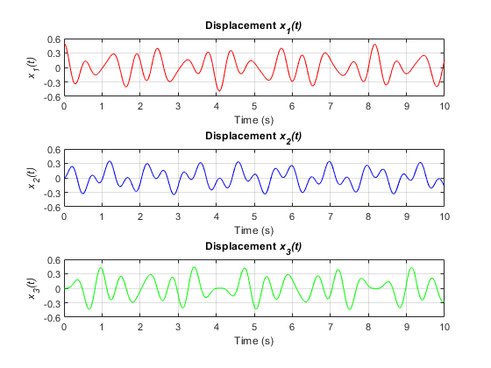
Simulink
Method of solving Ordinary Differential Equations with block diagrams to solve for ODE
MEGC MATLAB Technical Workshop
October 29th, 2020

Slide 44
Excel Editing and Reading
xlsread('Filename.xls’)
writetable(A ,'Filename.xls’)
MEGC MATLAB Technical Workshop
October 29th, 2020

Slide 45
Additional Resources
MEGC MATLAB Technical Workshop
October 29th, 2020

Slide 46
Additional Resources
Practical Guide to MATLAB & Simulink for Engineers
1-hour refresher course with asynchronous examples
Control Tutorials for MATLAB & Simulink (U-Mich)
Modules include lectures and examples to systems (modeling, analysis), controls (PID, root locus, frequency, digital controls, state-space) and Simulink (modeling, control, simscape)
Official MathWorks MATLAB and Simulink Training
Formal courses in MATLAB, Simulink and Image Processing.
Potential certifications
MEGC MATLAB Technical Workshop
October 29th, 2020

Slide 47
10 Minute Break/Q&A
MEGC MATLAB Technical Workshop
October 29th, 2020

Slide 48
Part 2: Application
MEGC MATLAB Technical Workshop
October 29th, 2020

Slide 49
Programming Flowchart
Step 1:
Input/Output?
Step 2:
If/for/while?
Step 3:
Functions?
Step 4:
Drawing
Step 5:
Start Coding
Step 6:
Debug
MEGC MATLAB Technical Workshop
October 29th, 2020

Slide 50
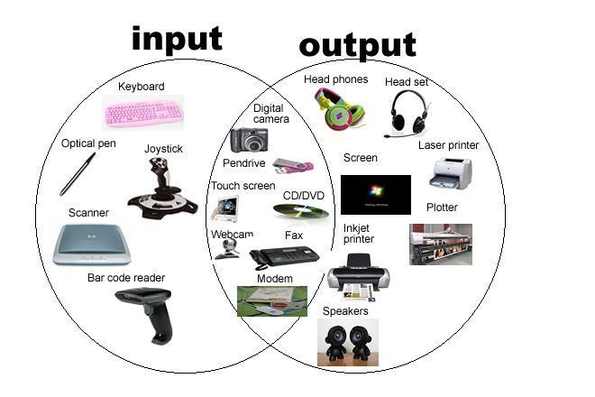
Programming Flowchart
Step 1:
Input/Output?
Step 2:
If/for/while?
Step 3:
Functions?
Step 4:
Drawing
Step 5:
Start Coding
Step 6:
Debug
MEGC MATLAB Technical Workshop
October 29th, 2020

Slide 51

Programming Flowchart
Step 1:
Input/Output?
Do I need
to meet any
conditions?
Step 2:
If/for/while?
Are there
need for
iterations?
Step 3:
Functions?
Step 4:
Drawing
Are iterations
finite or
conditional?
Step 5:
Start Coding
Step 6:
Debug
MEGC MATLAB Technical Workshop
October 29th, 2020

Slide 52

Programming Flowchart
Step 1:
Input/Output?
Step 2:
If/for/while?
Step 3:
Functions?
Step 4:
Drawing
Step 5:
Start Coding
Step 6:
Debug
MEGC MATLAB Technical Workshop
October 29th, 2020

Slide 53
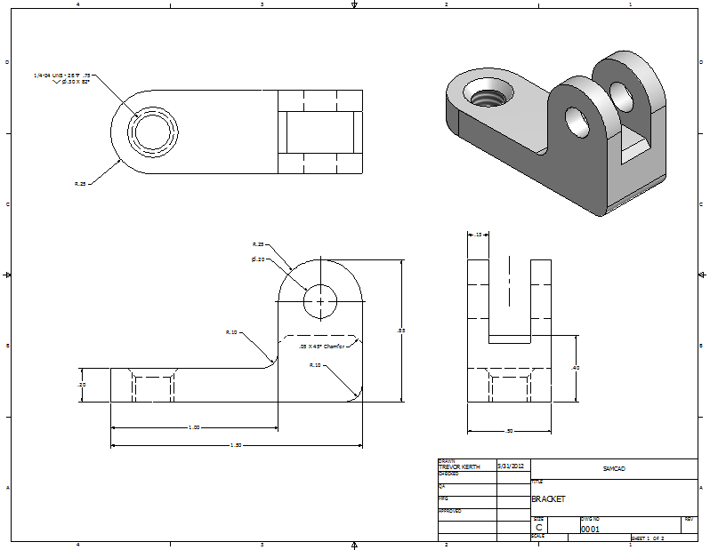
Programming Flowchart
Step 1:
Input/Output?
Step 2:
If/for/while?
Step 3:
Functions?
Step 4:
Drawing
Step 5:
Start Coding
Step 6:
Debug
MEGC MATLAB Technical Workshop
October 29th, 2020

Slide 54

Programming Flowchart
Step 1:
Input/Output?
Step 2:
If/for/while?
Step 3:
Functions?
Step 4:
Drawing
Step 5:
Start Coding
Step 6:
Debug
MEGC MATLAB Technical Workshop
October 29th, 2020

Slide 55
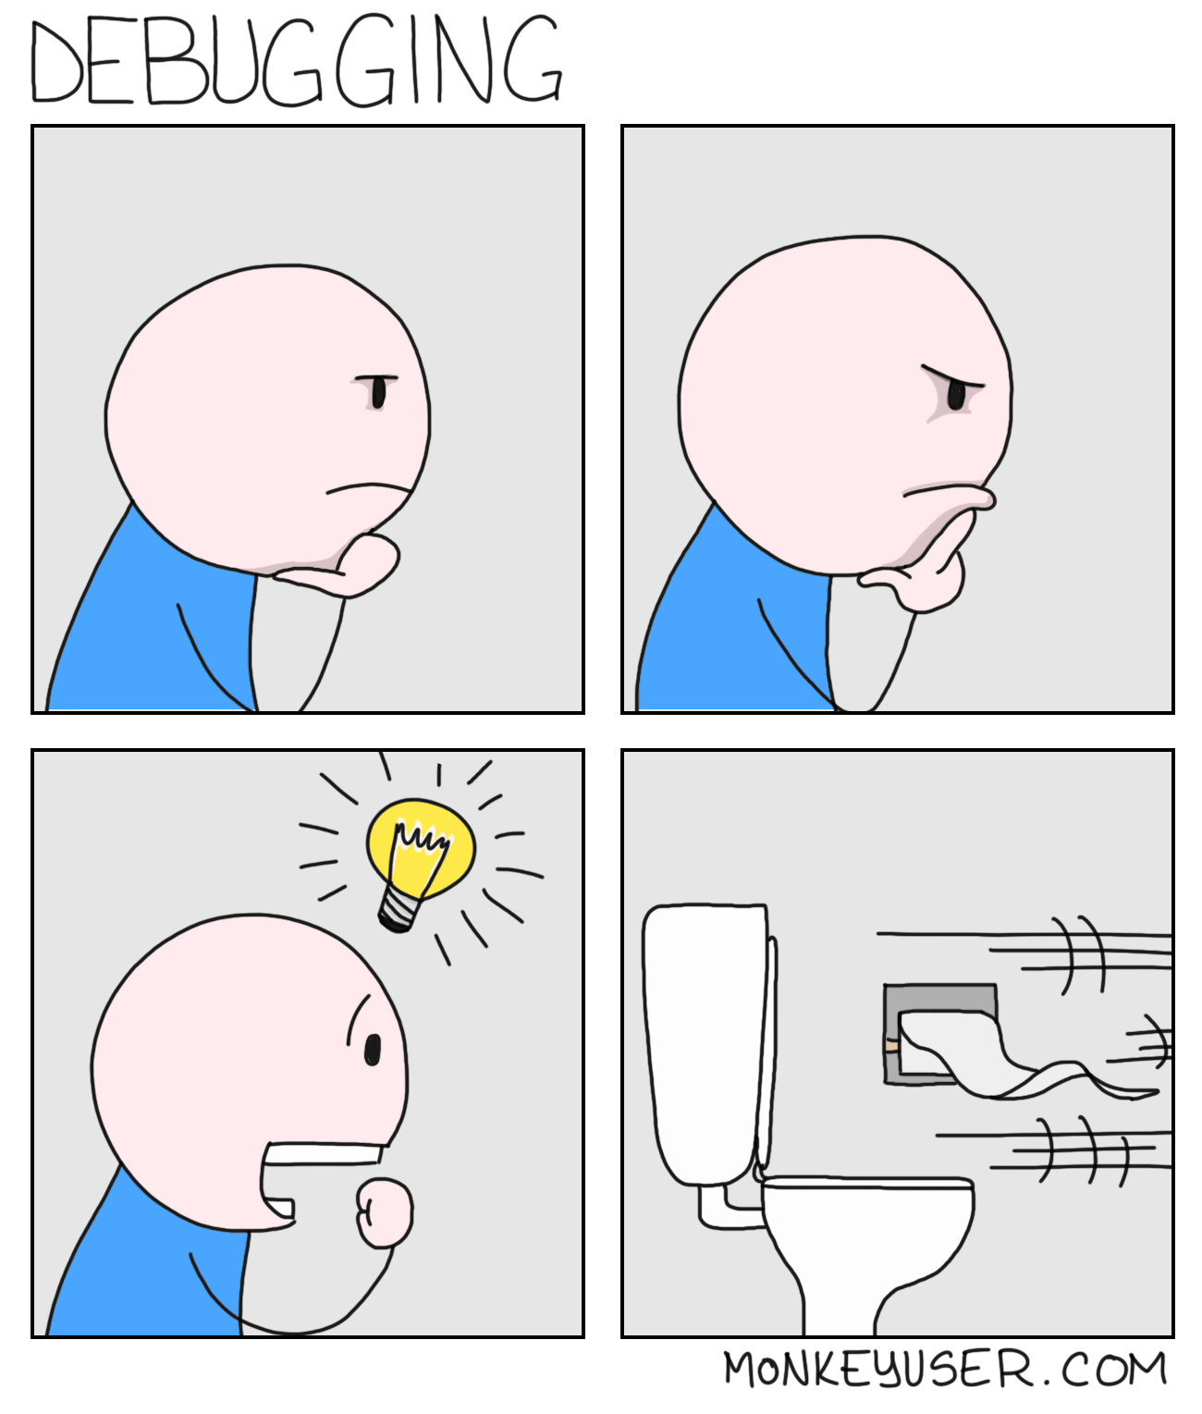
Programming Flowchart
Step 1:
Input/Output?
Step 2:
If/for/while?
Step 3:
Functions?
Step 4:
Drawing
Step 5:
Start Coding
Step 6:
Debug
MEGC MATLAB Technical Workshop
October 29th, 2020

Slide 56
Examples (Open up LiveScript File)
MEGC MATLAB Technical Workshop
October 29th, 2020

Slide 57
For Questions or Comments, Contact:
dnikolov@umich.edu
Get to coding!
MEGC MATLAB Technical Workshop
October 29th, 2020

